Slide 1


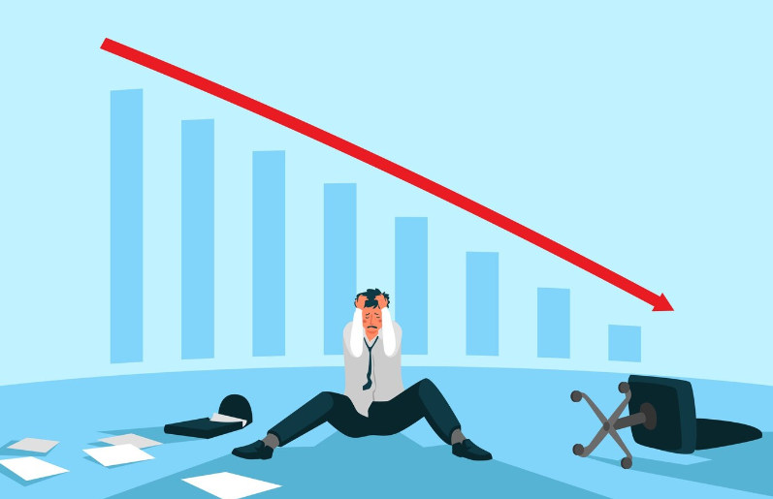

Origin of Our Platform

Slide 2
Amar Dokan-The Business Media Platform
A Multipurpose Business Platform for connecting all the businessman and the entrepreneur
01
Notes:
Assalamualaikum everyone . The name of our project is “Amar Dokan” the business media platform.

Slide 3
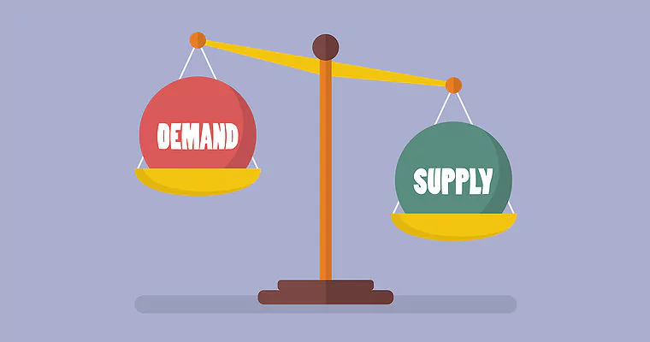
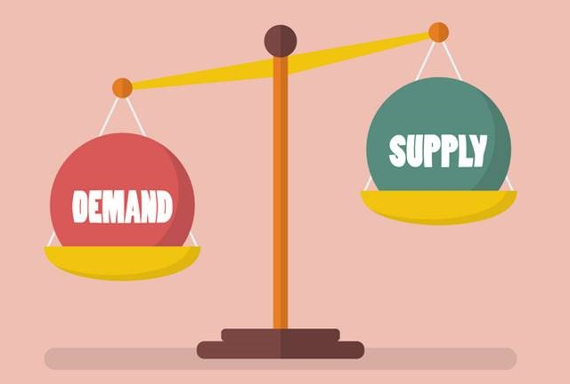
Problem
Low Demand − High Stock
High Demand − Low Stock
02
Notes:
we can address the problem as “ low demand – high stock” & “high stock – Low demand”. Which is very serious issue for startup and business

Slide 4
Case Study
Most of the entrepreneurs are now focusing on online business and e-commerce platform. Here is the
Failure Rate of E-Commerce and Online Business in Bangladesh
https://www.investopedia.com/articles/personal-finance/040915/how-many-startups-fail-and-why.asp
03
Notes:
From a recent we got some statistics , which shows that almost 90% new startup or business , failed to survive within the first 15 years. Same thing is happening in Bangladesh also.

Slide 5

Reasons for this colossal failure
Failure to differentiate the market
Lack of proper business planning and forecasting
Not having the expert idea about running the e-commerce business
Lack of idea about cash flow
Poor Inventory Management System
No ERP system integrated
Poor website and mobile app with less traffic
Lack of patience among a lot of competition
https://brainstation-23.com/ecommerce-failing-bangladesh-part-1/
04
Notes:
We find out some major reasons for this colossal failure like 50% business fail due to ERP.

Slide 6
Solution
We require a platform to connect customers, entrepreneurs, and other business entities seamlessly.
Our objective involves maintaining proper distribution channels for goods.
05
Notes:
That’s why our main objective is to ensure that new businessman or entrepreneur does not face any loss in the early stage.
Now the question is how we are going to reach our objective. Well! The solution is simple. We need a platform to connect all the business entities to bring stability to the supply chain by maintaining the proper distribution of the goods.

Slide 7
Introduction
“Amar Dokan- আমার দোকান" a Facebook like multipurpose Business media platform to connect customers, entrepreneurs and other business entities. Our goal is to bring stability in supply chain so that we can bring down the failure rate of entrepreneur.
06
Notes:
At this point let me introduce with our business platform “Amar Dokan” which is basically a multipurpose business media platform like facebook or linkdin.

Slide 8
Types of Seller
01
02
03
Type-1 Seller
Type-2 Seller
Type-3 Seller
Unable to sell due to lack of demand.
Having decent stock
Unable to sell.
low inventory despite high demand
who don’t have connection with supplier or wholesaler
07
Notes:
In our platform we divided all the businessman or entrepreneur into 3 categories. Type 1 seller, Typw 2 seller and Type 3 seller.

Slide 9
How it will work??
Type2 Seller
Type3 Seller
Type1 Seller
Our Platform
Investor
Consumer
Type1 Seller
Type2 Seller
Type3 Seller
Text 4
08
Notes:
Our main objective is to interconnect this 3 type of seller with each other . so that they can easily find and connect with their respective consumers.

Slide 10
Fields
ERP Modules
Investment
Shop
Accounting
Product
Company
B2B
B2C
Customers
Inventory
Suppliers
Shop + Entrepreneur
HRM
Short Term
Mid Term
Long Term
09
Notes:
So our project will work focusing on these three things. Shop, ERP module and Investment.
The concept of shop in our in our platform is like having a virtual copy of the physical store of the business.
We provide global standard ERP module to our clients. If any one need, we provide them with customized ERP module.
Investment has two parts- Products and Company. Anyone can invest in the product. But investing in a company by the investors will be contractual. Here we are establishing a concept of pocket money ivestment.

Slide 11
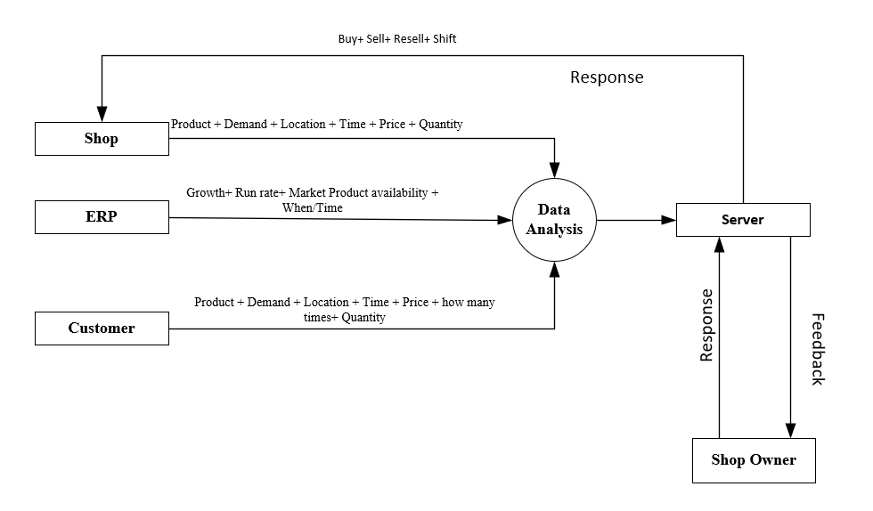
Methodology
10
Notes:
Our methodology is to use all the important parameters like (product, demand, growth etc.) from the shop, ERP and customers and analyze those for giving them a suitable feedback for growing their business.

Slide 12
Services and Uniqueness's
Business Status & Prediction
ERP
Product Shifting
Dynamic Web Builder
Consignment Sales
Nearest Shop Finder
11
Notes:
We will offer various services to our clients(ERP, product shifting, nearest shop finder etc.).

Slide 13
Target Users
Students
Entrepreneur
Companies
Shops
Total = 10.2M
Total Target = 1.025M
12
Notes:
We categorize our targets in 3 categories. Our total amount of audience is 10.2 million. In the worst case scenario we will get approximately 1.025 million which is 10% of the total audience.

Slide 14

Market Size
Study Period | 2019 - 2029
Market Size (2024) | USD 0.65 Trillion
Market Size (2029) | USD 1.10 Trillion
CAGR (2024 - 2029) | 11.23 %
Serviced Market (2023) | USD 468.51 Billion
13
Notes:
This is the market size. but according to our services the real market is around 8 Trillion dollar

Slide 15

Estimated Time Frame
Research And Development
First Year
(i) Marketing And Preregistration
Second Year
(ii) Feedback And Improvement
Final Product
Third Year
14
Notes:
This is out 3 year time frame

Slide 16
Costing
Topics | Year | Cost(Dollar)
Research & Development | First | 387.3 k
Marketing, Preregistrations And Improvement | Second | 370.2k
Final Product & Marketing | Third | 360.2 k
Total | 3Year | 1.12 M
Required Investment: 1.12M
15
Notes:
According to our costing we need investment about 1.12M

Slide 17

Revenue Source
Advertising
Premium Access Subscription
Custom Service
Investment Account
Unsold Stock
Consignment Sales
Transection
Transportation
17
Notes:
Our revenue source is similar to other online shop and social platform like Advertising, premium Access subscription, customer services etc.

Slide 18
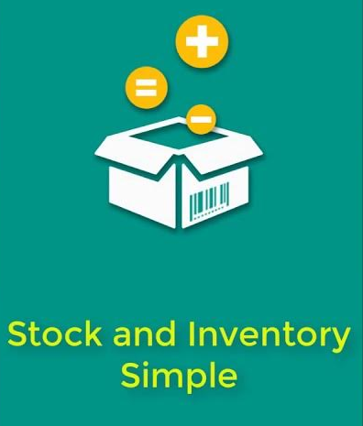


Competition
18
Notes:
We don’t have any direct competitors. Our closest competitors in Bangladesh are Smanager, Hisabee and Stock and Inventory Simple

Slide 19

Challenges
As it’s a large platform, it will take a lot of time and eligible manpower to implement
Need to raise big fund for organizing
Competitors Reaction
19
Notes:
Now the challenge is we need a huge fund and skilled manpower to organize this platform

Slide 20
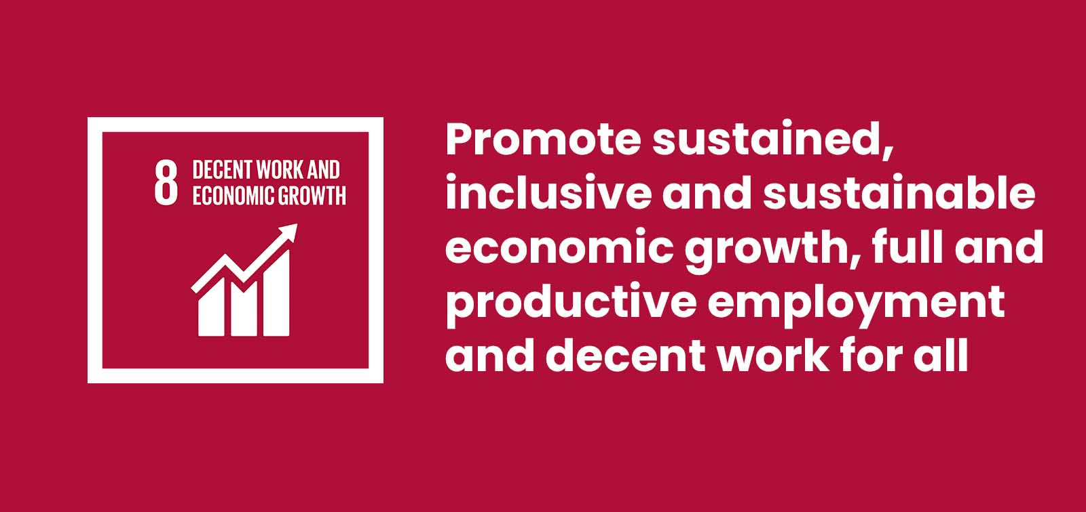

Sustainable Development Goals
20
Notes:
Our concept aligns with these SDG Goles.

Slide 21
References
https://www.investopedia.com/articles/personal-finance/040915/how-many-startups-fail-and-why.asp
https://brainstation-23.com/ecommerce-failing-bangladesh-part-1/
https://explodingtopics.com/blog/startup-failure-stats
https://www.entrepreneur.com/starting-a-business/the-true-failure-rate-of-small-businesses/361350
https://futurestartup.com/2016/04/04/05-startups-failed-bangladesh-last year/#:~:text=Statistically%2C%209%20out%20of%2010,wayside%20and%20die%20silent%20deaths.
https://betterstories.limited/2021/01/20/why-do-start-ups-fail/
https://www.ceicdata.com/en/bangladesh/businesses-registered-statistics
https://markedium.com/smes-of-bangladesh-the-present-scenario-and-future-prospects/#:~:text=The%20industry%20is%20an%20important,are%20established%20in%20rural%20areas.
https://thefinancialexpress.com.bd/views/youth-entrepreneurship-through-smes-can-change-bangladeshs-economic-landscape-1656492318
https://www.thedailystar.net/shout/cover-story/news/the-entrepreneurs-today-1772953
https://www.cnbc.com/2022/03/03/60percent-of-teens-want-to-launch-businesses-instead-of-working-regular-jobs.html
https://www.oecd-ilibrary.org/sites/3ec10f3b-en/index.html?itemId=/content/component/3ec10f3b-en
https://www.youthbusiness.org/what-we-do
https://wpforms.com/the-ultimate-list-of-online-business-statistics/
https://firstsiteguide.com/online-business-stats/
https://www.oberlo.com/blog/ecommerce-statistics
https://www.tbsnews.net/economy/bangladesh-e-commerce-sales-more-double-2026-research-497134
21
Notes:
here is the available references

Slide 22

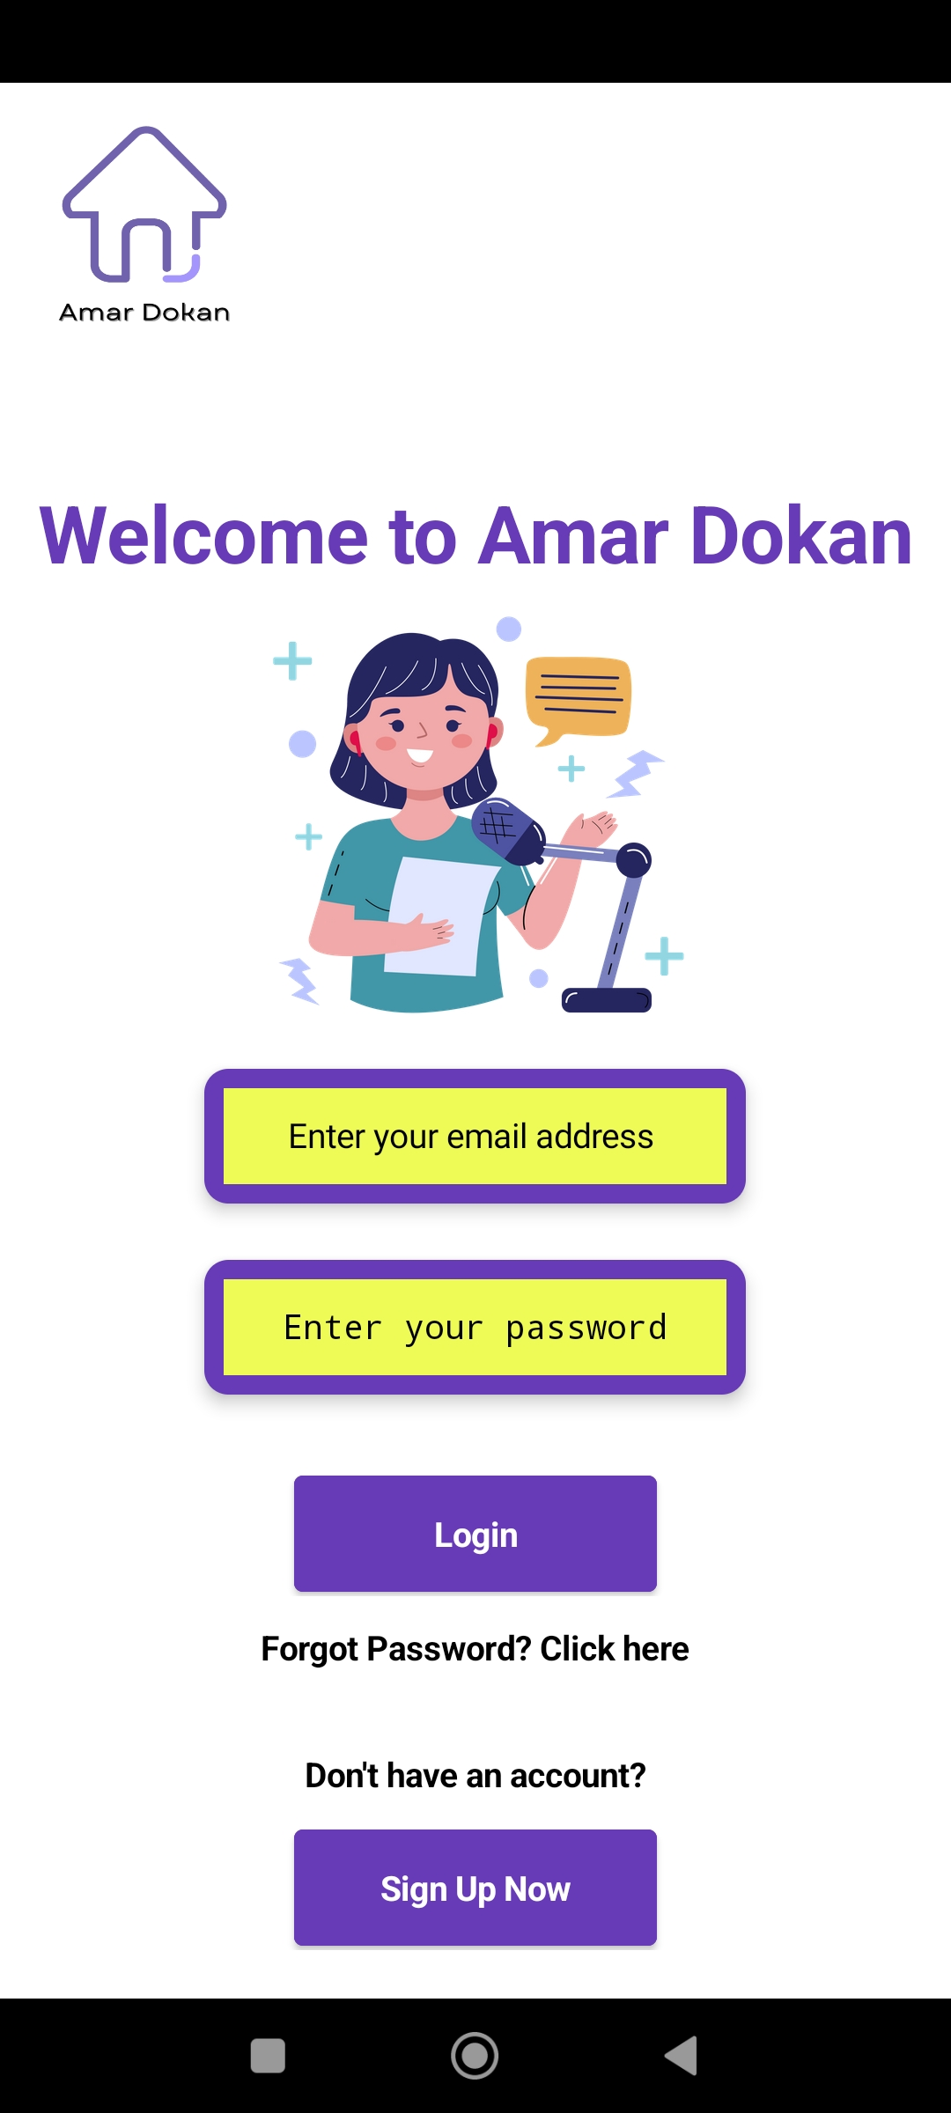
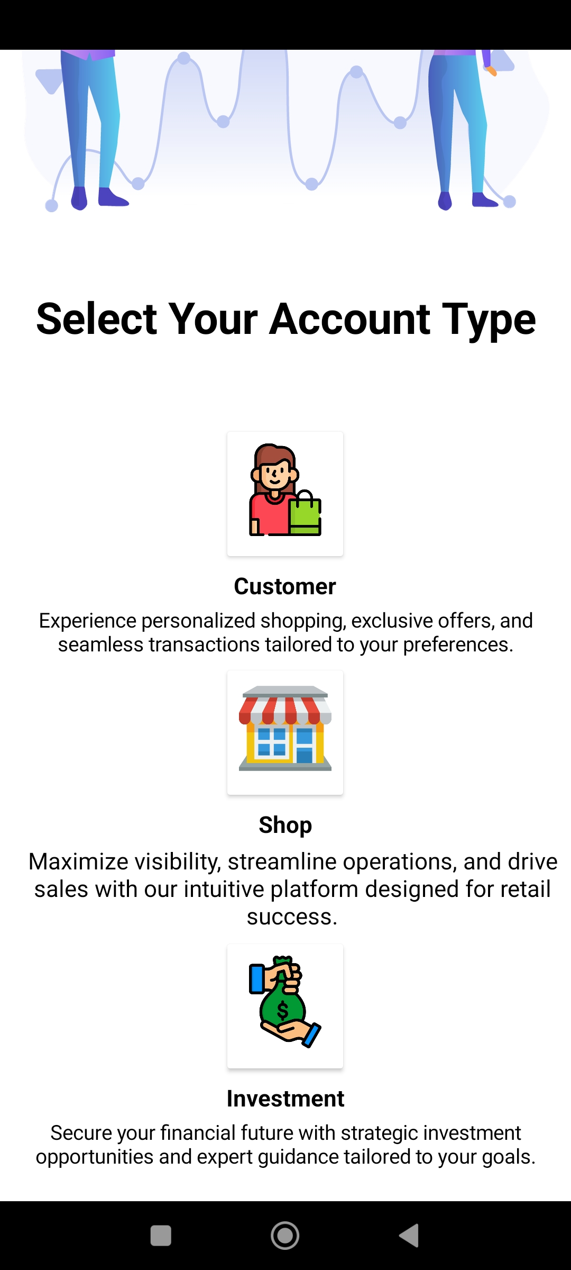
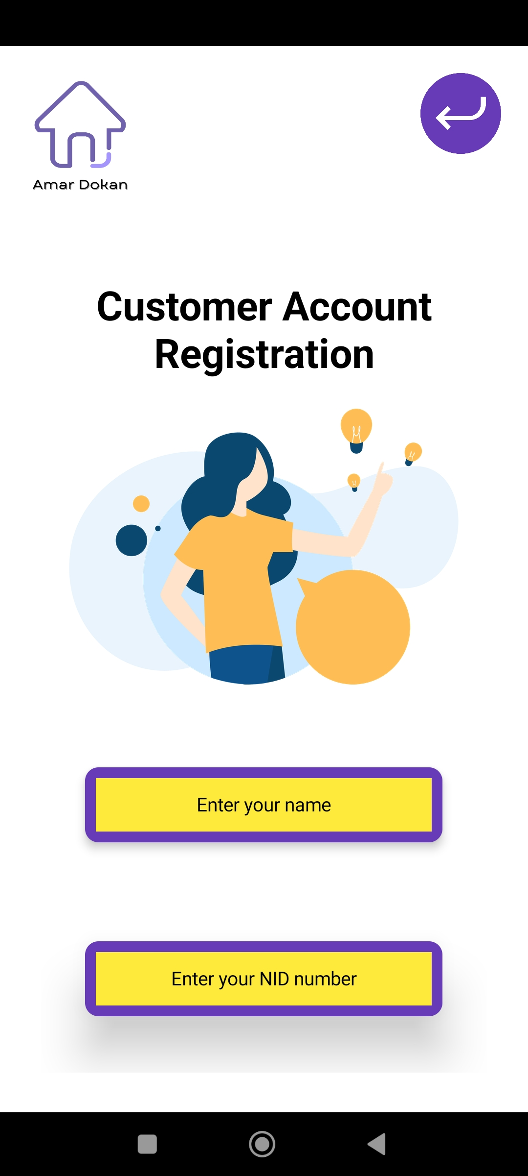
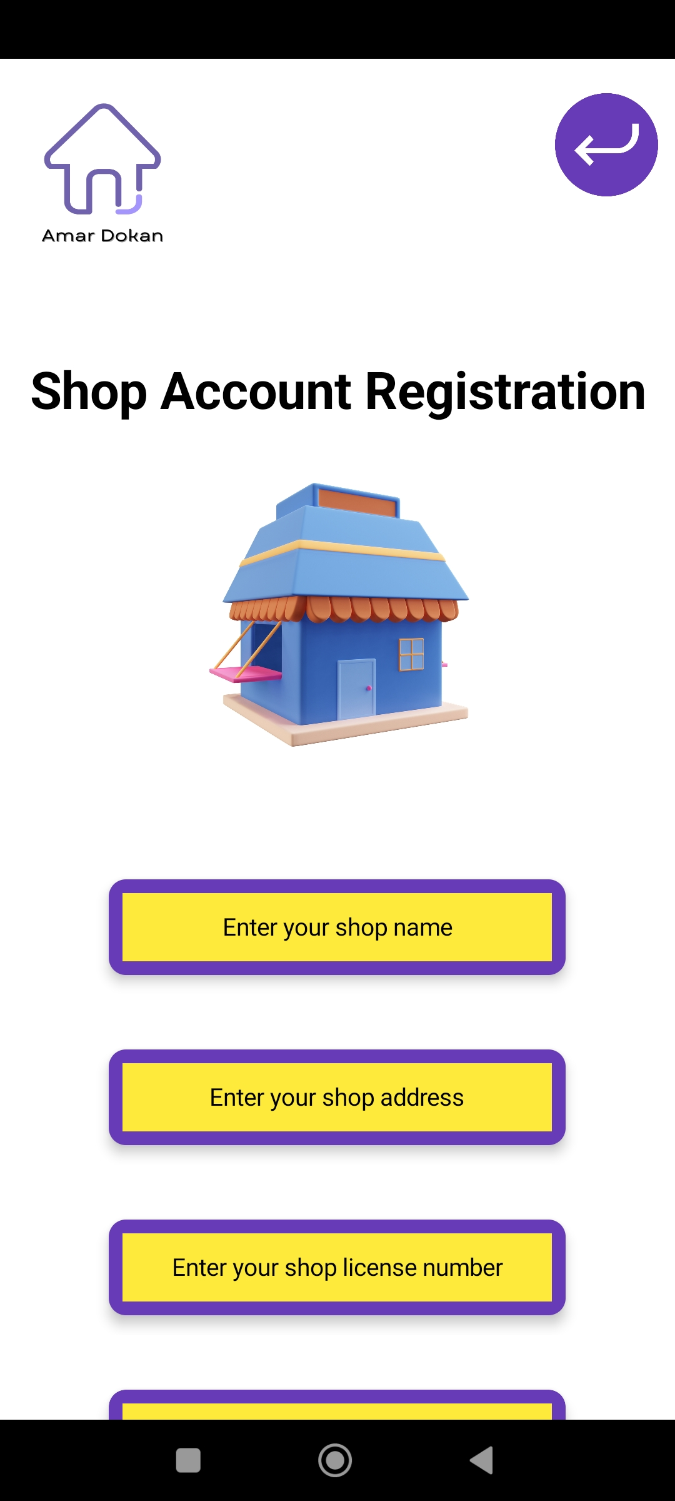
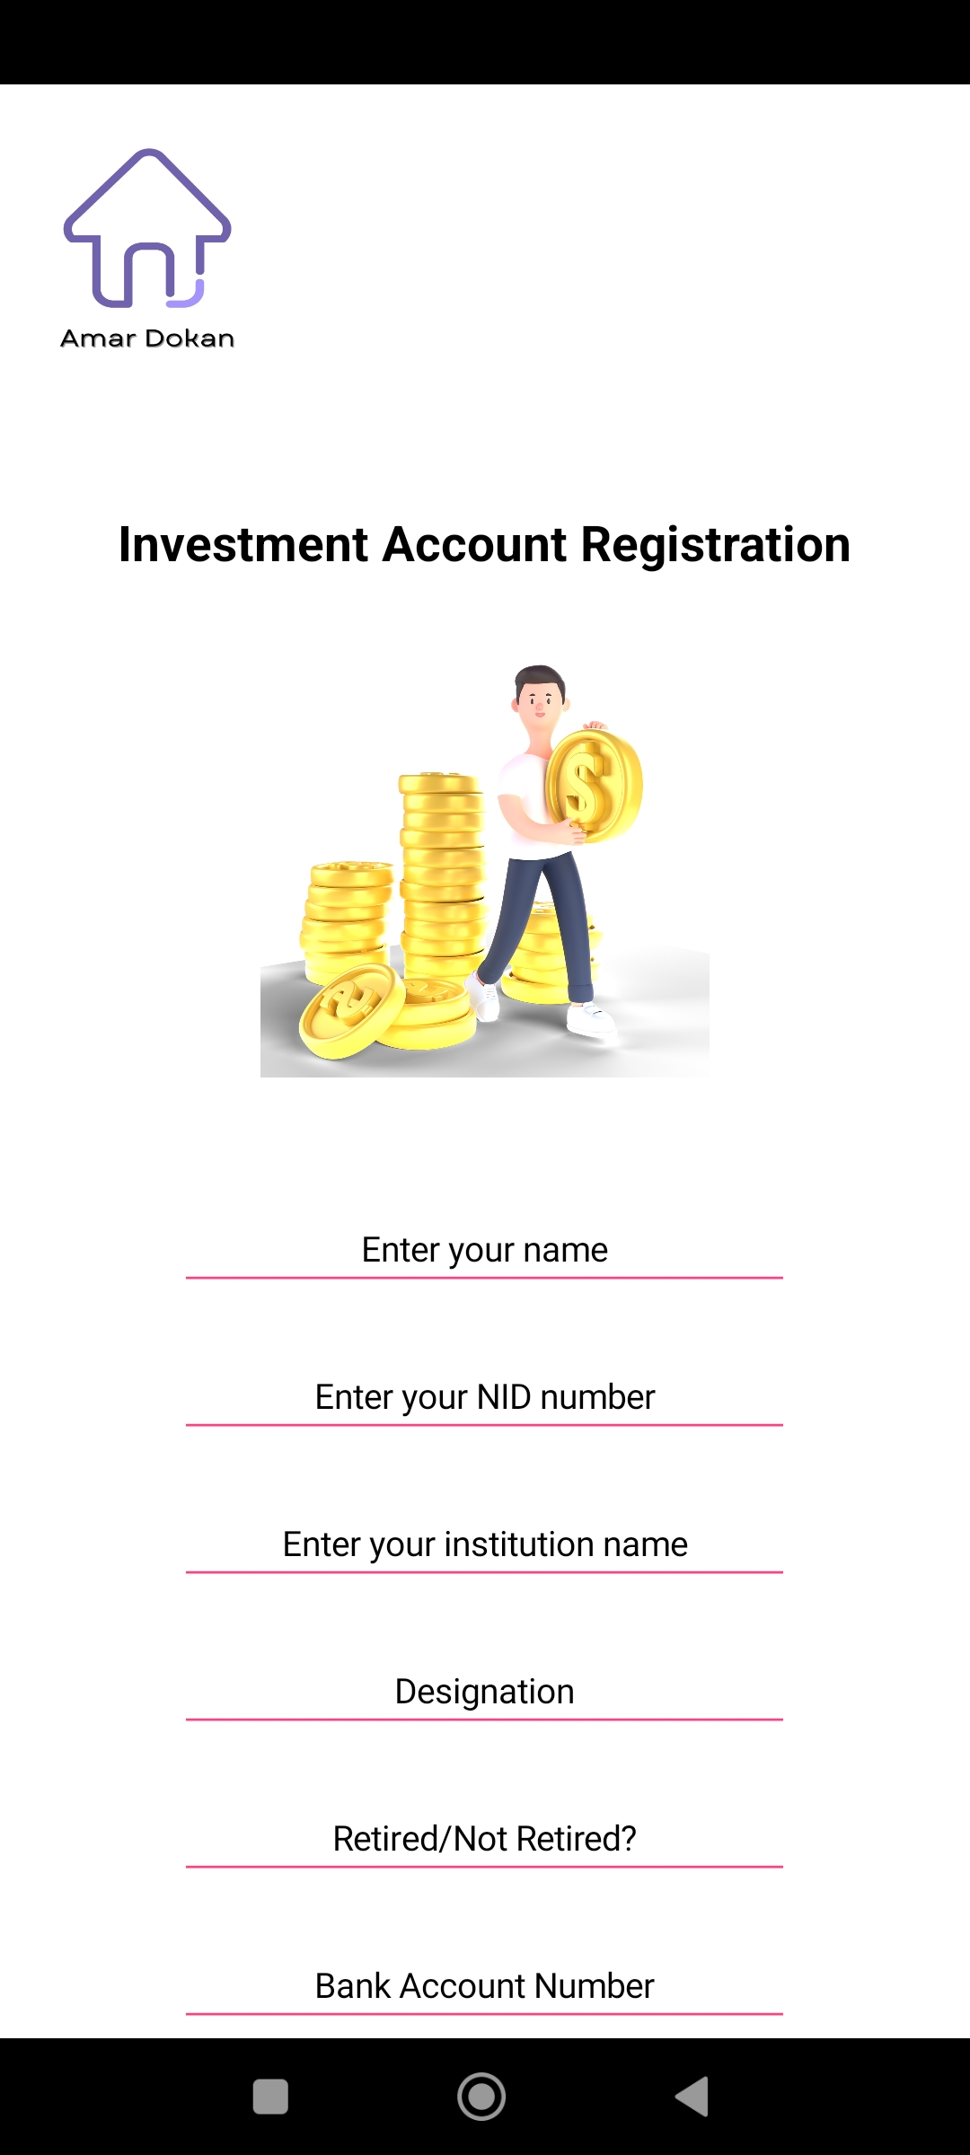
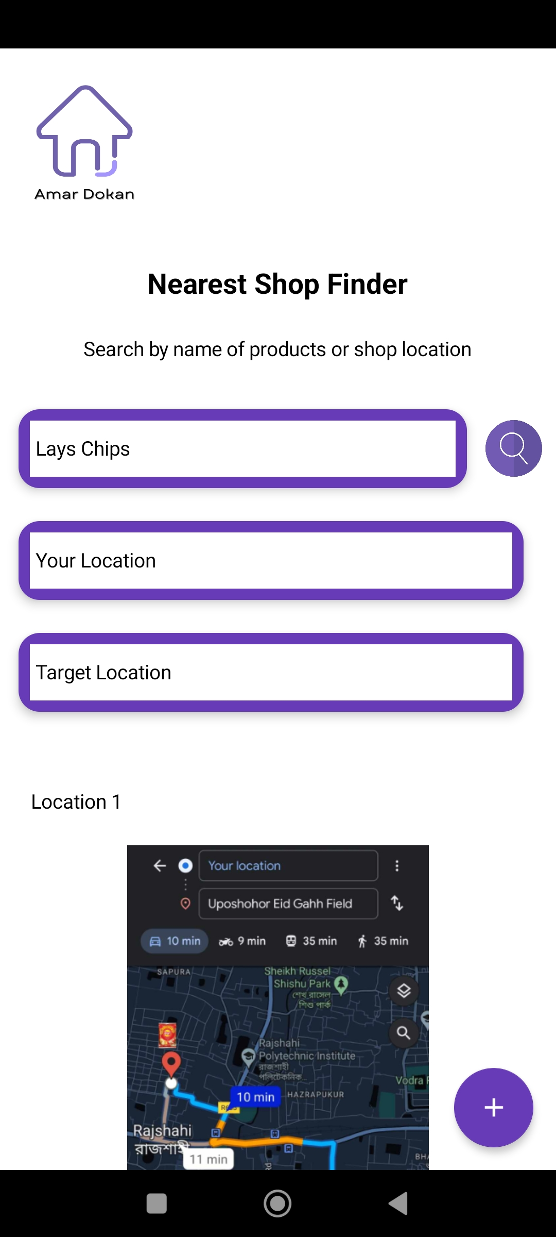
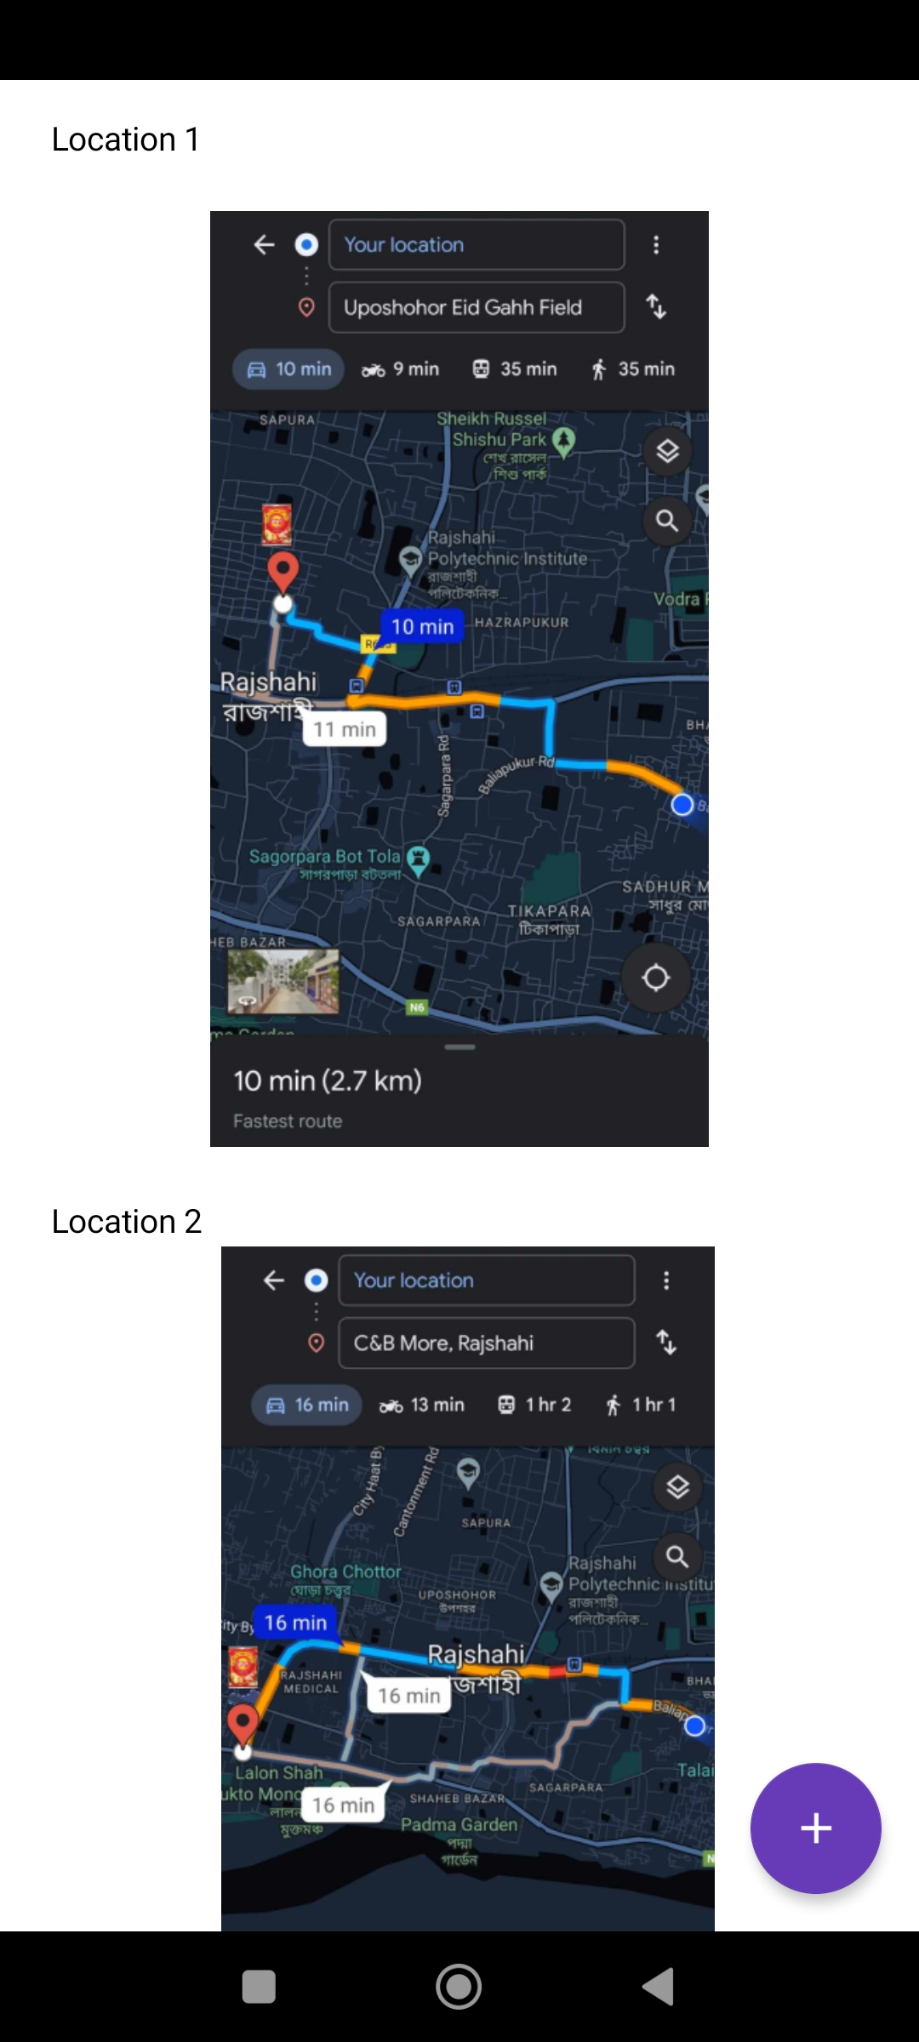
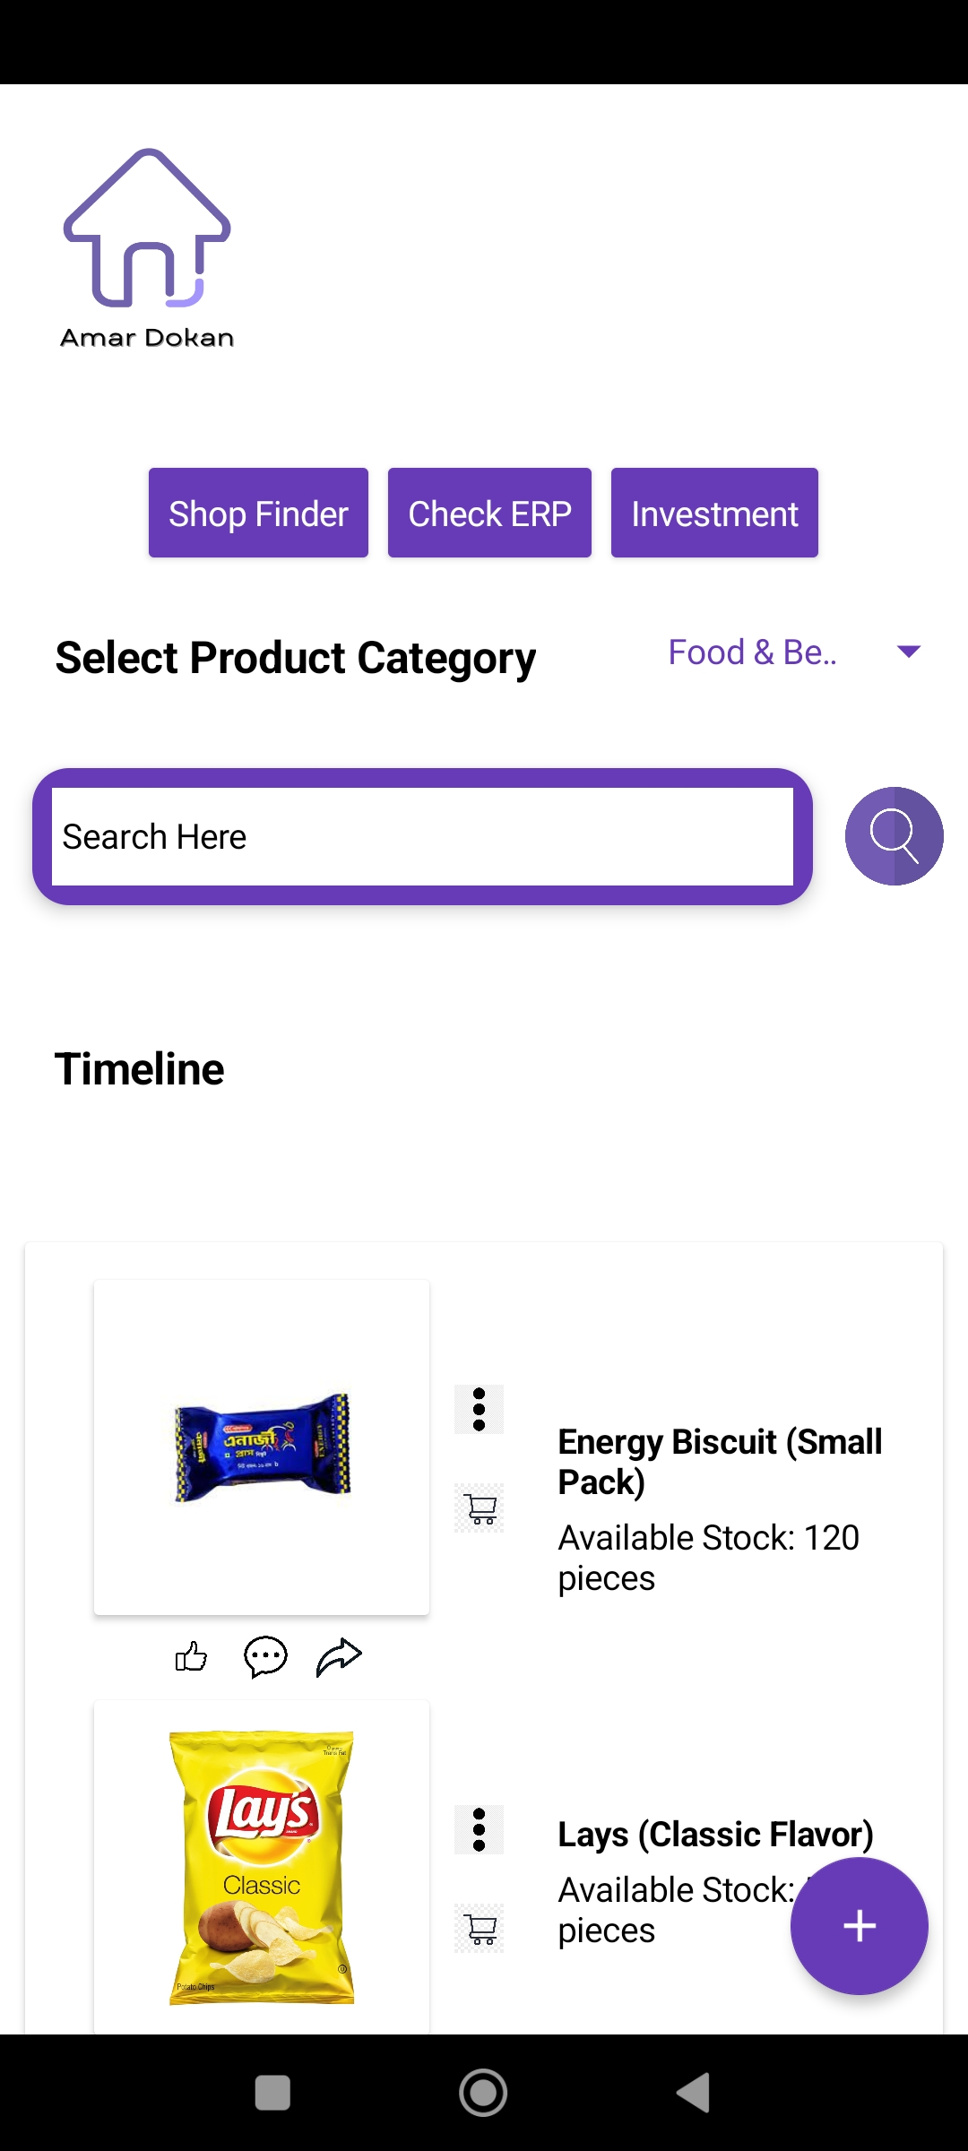
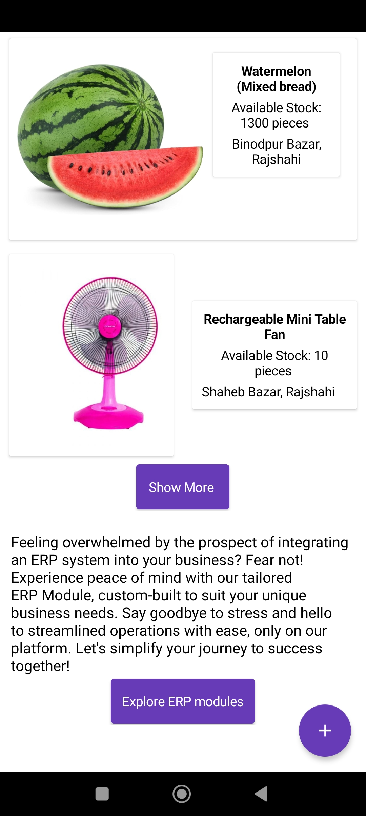
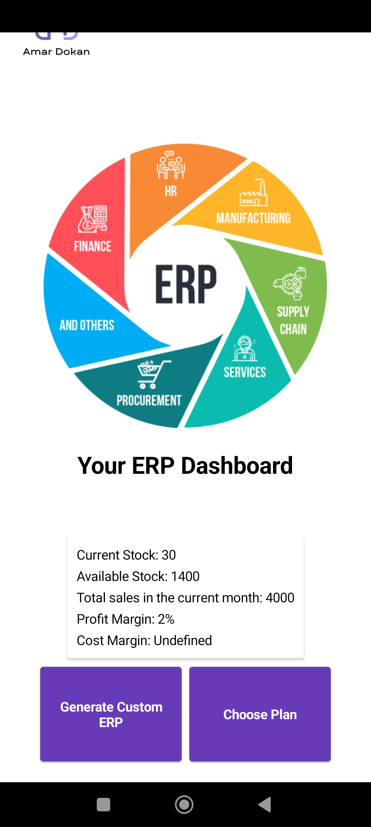
Proof Of Concept
22
Notes:
Here Is the product ‘s Prototypes main feature’s model

Slide 23

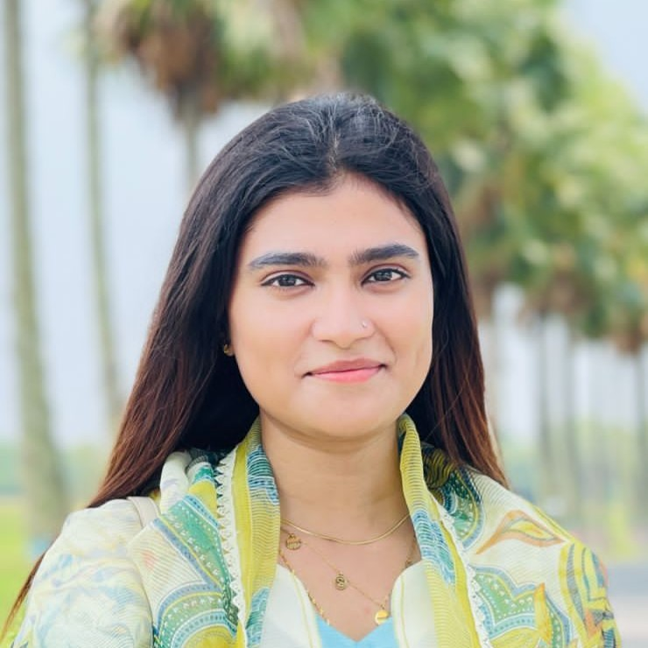
Team - PROGOTI
Esrat Jahan Eva (CSE)
Co-Leader & CTO
Manages technology development, app features and AI
Soniya Akter (CSE)
Leader & CEO
Leads overall business strategy, operations, and growth.
20
Notes:
Our concept aligns with these SDG Goles.

Slide 24
Team - PROGOTI
“ The power of connection, the future of business “
Amar Dokan
Thank You
20
Notes:
Our concept aligns with these SDG Goles.

